Slide 1

Capacity Market Advisory Group (CMAG)
Meeting 45
CMAG Secretariat
16 June 2026

Slide 2
Meeting Agenda
Agenda Item ​ | Number ​ | Lead ​ | Approx Time​
Standing Items​
Welcome and Apologies​ | ​ | Simon Dawes (CMAG Facilitator)​ | 10:00
CM Representative Updates​ | ​ | CM Settlement Body; EMR Delivery Body; Ofgem and DESNZ​ | 10:05
CMAG Secretariat Update​ | ​ | ​Simon Dawes | 10:30
Industry Feedback |  | Simon Dawes | ​10:35
Discussion Items
CP373 follow-on items | 45/01 | Paul Farmer
Secondary Trading review | 45/02 | Chris Arnold
Decision Items
CP399: Capacity Provider obligations when disconnected due to TO/DNO infrastructure. | 45/03 | Chris Arnold
Information Items
Forward Work Plan |  | All
Any Other Business (AOB) |  | All
Break Type | Approx Time
Comfort Break | 11:30 – 11:40
Lunch | 12:45 – 13:30

Slide 3
CP394 – Conditional prequalification for assets that have applied for a new or modified connection date
Post-consultation changes
16th June 2026

Slide 4
CP394 post-consultation proposed changes
CP394 allows parties that currently have pending offers under the Connections Reform process to participate in PQ2026
It updates CP388 which was introduced for PQ2025 and which specifically aimed to allow projects to participate where these might be accelerated (into a qualifying connection date) under Connections Reform
Based on the consultation responses we are planning to add some text to clarify the support for extending conditional prequalification to enable participation of all qualifying projects awaiting Gate 2 offers, but balancing this with safeguards to align with Connections Reform changes and to preserve delivery assurance
A key point that we would like to get CMAG feedback on since it is part of this balance is the status of projects with agreements that are still unsigned at the deadline date before the auctions
The text as written would exclude these. In PQ25 while the proposals under CP388 were more limited unsigned agreements were allowed
The pros and cons are that allowing unsigned offers is more inclusive; but it can cause additional problems with disputes, introduces further ambiguity and makes the overall process less clearcut

Slide 5
Updated legal text – amended from CP388
Here is the text already consulted on: (redline changes, generally to the text introduced under CP388)
3.7.3(aza): For the Prequalification Window during 2025 2026 only, an Applicant in respect of a T-4 Auction which is a New Build CMU that is or will be a Transmission CMU (a “relevant CMU”) and is unable does not have a Grid Connection Agreement that would allow the Applicant to give the confirmation in Rule 3.7.3(a)(i), or does not intend to rely on that Grid Connection Agreement for Prequalification, may, instead of complying with Rule 3.7.3(a):
(i) provide with their Application:
(aa) a copy of the current Grid Connection Agreement, if they have one, for each Generating Unit comprising the CMU or, if they do not have a Grid Connection Agreement, then a declaration confirming they do not have one;
(bb) a declaration that, in 2025 or 2026, the Applicant has applied for ana new, modified or advanced connection date that would enable the Generating Units comprised in the relevant CMU to comply with the requirements under Rule 3.7.3(a)(i) and will, if that advanced connection date is granted, provide a copy of the revised Grid Connection Agreement on or before the date that is 16 22 Working Days prior to the commencement of the first Bidding Window for the T-4 Auction for the 2029/2030 2030/2031 Delivery Year; and
(cc) evidence of its request to the National Energy System Operator for a connection date that would enable the Generating Units comprised in the relevant CMU to comply with the requirements under Rule 3.7.3(a)(i) and a copy of the receipt issued confirming submission of the connection application.
(ii) on or before the date that is 16 22 Working Days prior to the commencement of the first Bidding Window for the T-4 Auction for 2029/2030 2030/2031 Delivery Year, provide a copy of the revised Grid Connection Agreement with a connection date that would enable the Generating Units comprising the CMU to comply with requirements under rRule 3.7.3(a)(i).
It is also necessary to add paragraph 3.7.3(aza)(iii) as follows to address some uncertainties in the earlier 2025 prequalification window process:
3.7.3(aza)(iii) provide with their Application a declaration that:
        confirms that, by complying with requirements under Rule 3.7.3(aza)(i)(aa)-(cc), their intention is to apply for conditional prequalification; and
        if they have submitted a GCA which complies with Rule 3.7.3(a)(i), confirms whether they intend for their Application to be considered for Prequalification on the basis of this originally submitted GCA , if they do not meet the requirements of the conditional prequalification 22 Working Days prior to the commencement of the first Bidding Window for the T-4 Auction

Slide 6
Updated legal text - additions
Then this is the part that we are proposing to add: (redline changes plus purple text post-consultation)
Firstly, paragraph 4.7C.1 added under CP388 was amended to change the dates. We are considering removing (b) from this to balance the new ability of any qualifying projects awaiting Gate 2 offers to participate by requiring all connection agreements to be signed before the auctions take place – as would normally be the case:
4.7C.1: An Applicant that has provided with its Application a declaration pursuant to Rule 3.7.3(aza)(i)(bb) must provide to the Delivery Body no later than 16 22 Working Days prior to the commencement of the first Bidding Window for the T-4 Auction for the 2029/2030 2030/2031 Delivery Year:
(a) the revised Grid Connection Agreement for each Generating Unit comprised in the CMU evidencing the capacity requirements in 3.7.3(a)(i).; or
(b) where the applicant is unable to provide a signed copy of the revised Grid Connection Agreement, the unsigned revised Grid Connection Agreement for each Generating Unit comprised in the CMU evidencing the capacity requirements in 3.7.3(a)(i).
Further additional text is required setting out the process around a Gate 2 Connection Agreement that may not have been available during prequalification:
3.7.3(azb) For the Prequalification Window during 2026 only, an Applicant which is a New Build CMU that complies with Rules 3.7.3(a), 3.7.3(aa), or 3.7.3(b) by providing a Grid Connection Agreement or Distribution Connection Agreement that is not a Post-Reform Gate 2 Connection Agreement must:
(i) provide a declaration with their Application that the Grid Connection Agreement or Distribution Connection Agreement it has provided is not a Post-Reform Gate 2 Connection Agreement, and that the Applicant does not possess a Post-Reform Gate 2 Connection Agreement that would comply with requirements under Rules 3.7.3(a), 3.7.3(aa), or 3.7.3(b); and
(ii) on or before the date that is 22 Working Days prior to the commencement of the first Bidding Window for the relevant Auction, provide a copy of the Post-Reform Gate 2 Connection Agreement with a connection date that would enable the Generating Units comprising the CMU to comply with requirements under Rules 3.7.3(a), 3.7.3(aa), or 3.7.3(b).
This also necessitates the addition of a further Rule following 4.7C.1:
4.7C.2 An Applicant that has provided with its Application a declaration pursuant to 3.7.3(azb)(i) must provide to the Delivery Body no later than 22 Working Days prior to the commencement of the first Bidding Window for the relevant Auction the Post-Reform Gate 2 Connection Agreement for each Generating Unit comprised in the CMU evidencing the capacity requirements in Rules 3.7.3(a), 3.7.3(aa), or 3.7.3(b).
Additionally, the following definition will be added to Rule 1.2.1:
Post-Reform Gate 2 Connection Agreement means a Distribution Connection Agreement or Grid Connection Agreement that has been modified by the DNO or System Operator following the Connections Reform Gate 2 to Whole Queue process and thus includes an Agreement to Vary badged in recitals as being the Gate 2 Modification.

Slide 7
Standing Items
1
2
3
4
Welcome and Apologies
CM Representative Updates​
CMSB​
EMR DB​
Ofgem​
DESNZ
CMAG Secretariat
Update​
Industry Feedback

Slide 8

Discussion Items (CMAG Surgery)

Slide 9
CP373 follow-on items

Slide 10
Presenter:​ Paul Farmer | Title:​ CP373 follow-on items | Agenda item:​ 45/01
CP reference number: ​CPXXX | Status:​ CMAG Development | Previous CMAG discussion:​ Meeting 32 (20 May 2025 as priority 3) Meeting 33 (17 June 2025 as priority 3) Meeting 34 (16 July 2025 as priority 4) Meeting 40 (20 Jan 2026 as 3&4) Meeting 41 (17 February 2026 as ADP) Meeting 42 (17 March 2026 as priority 3)
Issues: Rule changes proposed that relate to Approved Metering Solution and Metering Configuration Solution. Misalignment between Transmission Licence C16 balancing service in paragraph 3.1 of Schedules 2 & 2A and the more limited Schedule 4 Relevant Balancing Services (RBS). Inconsistencies between DSR Test and Stress Event Baseline Methodologies.
Purpose of discussion: Discuss proposals. Prioritisation - Inconsistencies between DSR Test and Stress Event Baseline Methodologies.
Next steps: ​ To be agreed.
10

Slide 11
Standardising the use of an
Approved Metering Solution from a submitted Metering Configuration Solution

Slide 12
Approved Metering Solutions
Background
Some Rules do refer to Approved Metering Solutions (AMS);
          8.3.3(i) / 9.2.5(ba) – Secondary Trading
          13.2.5(b)(ii) / 13.2B.5(b)(ii) - DSR Tests.
          13.3.1 / 13.3.6(a)(iii) / 13.3.6B(a)(iii) - Metering Tests.
The continuing reference to MPANs or BMUs in some Rules appear out of sync with the ultimate requirement for an Approved Metering Solution (AMS).
Why is it important to implement this proposed change?
    CMAG Secretariat believes it follows DESNZ’s desire to simplify the Rules.
    Also retaining BMU or MPAN references in certain place’s, risks inconsistencies between such Rules where a CMU is comprised of Generating Units with complex metering.
Proposing key requirements around metering should be standardised.
    Amend AMS to simplify it to recognise EMRS approval of a Metering Configuration Solution (MCS).
    MCS definition will then specify 4 types of Meter Configuration more simply.

Slide 13
Approved Metering Solutions
Proposed simplification of Rule 1.2 Definitions:
Approved Metering Solution | means (a) a Metering Configuration Solution (including CM Aggregation Rules) approved by the CM Settlement Body which is an arrangement of Metering Equipment for: (i) a Generating Unit that is not a BM Unit; (ii) a DSR CMU Component that is not a BM Unit; or (iii) a CMU that is a partial BM Unit; or (b) a Metering Configuration Solution in respect of a Generating Unit or DSR CMU Component where such Metering Configuration Solution is comprised of a BM Unit that is registered in the Central Meter Registration Service in accordance with the BSC and CM Aggregation Rules are in place

Slide 14
Approved Metering Solutions
Proposed simplification of Rule 1.2 Definitions:
Amend MCS to include new definition of Central Meter Registration Service Metering Configuration Solution.
Metering Configuration Solution | means, as applicable, any one of the following: (a) Balancing Services Metering Configuration Solution; (b) Bespoke Metering Configuration Solution; or (c) Supplier Settlement Metering Configuration Solution; or (d) Central Meter Registration Service Metering Configuration Solution.
Balancing Services Metering Configuration Solution | No change
Bespoke Metering Configuration Solution | No change

Slide 15
Approved Metering Solutions
Proposed simplification of Rule 1.2 Definitions:
Add Central Meter Registration Service Metering Configuration Solution using the text from Definition AMS(b).
Central Meter Registration Service Metering Configuration Solution | means a Metering System in respect of a Generating Unit or DSR CMU Component comprised of a BM Unit that is registered in the Central Meter Registration Service in accordance with the BSC, and CM Aggregation Rules are in place
Supplier Settlement Metering Configuration Solution | With Ofgem under CP392, proposal below:
BSC Supplier Settlement Metering Configuration Solution | means a Metering System that uses a supplier’s Half Hourly Metering System by using Half Hourly Data Aggregators to collect metered data means a supplier’s Metering System or Asset Metering System that can record UTC Period Level Consumption for use in Settlement, and for which UTC Period Level Consumption data is provided by a Half Hourly Data Aggregator, Half Hourly Data Collector or the Market-wide Data Service.
Notes:
CP392 – is the adjustment to allow COP 11 meters to be added as an additional Metering Solution in the CM, reducing reliance on Bespoke Metering Config Solution.

Slide 16
Approved Metering Solutions
Rules Amendment
3.4.3 Nominations relating to the CMU
Each Applicant must:
          specify in the Application:
    (iii) BM Unit Identifiers (as defined in the Balancing and Settlement Code) Metering Configuration Solution, if applicable;
Original CP373 EMR DB comment
Keep this Rule because Existing Generating CMUs have to demonstrate previous performance in 3 SPs under 3.6.1, then all Applications under 3.4.3(a)(iii) have to provide BMU [identifiers], if applicable.
Previous CMAG discussion
Will this mean a CMU must go back to Elexon (EMRS) and restate what metering or aggregation sits behind the BMU?
  Having to restate previously provided information is not the intention. 3.4.3 applies to all Applications, but no CMUs have to provide a Metering Assessment (containing the MCS) under Rule 8.3.3 at Application.
CMAG Secretariat question
Would it be better to move 3.4.3(a)(iii) to within 3.6.1(a) Additional Information for an Existing Generating CMU?
  Note that 3.6.1(b/c) relates to non-CMRS CMUs.
Notes:
3.4 Information to be provided in all Applications. Metering information is no longer included as part of the Prequalification process. Rules that previously required metering information be provided have been omitted from the Rules. My understanding is this was done because the responsibility for ensuring metering requirements are meeting the required standards sits with EMRS, and EMRS are not involved in the prequalification process. This rule should remain as it is.

Slide 17
Approved Metering Solutions
Rules Amendment
4.4.2 Subject to Rule 3.8.1A(c)(ii), the Delivery Body must not Prequalify a CMU where:
(c) any Meter Point Administration Number Meter Configuration Solution specified in relation to the CMU pursuant to Rule 3.4.3(a)(ii) has already been registered to another CMU in respect of which a person either:
(i) has a Capacity Agreement in relation to one or more of the same Delivery Years; or
(ii) has submitted a prior Application in the same Prequalification Window,
unless the Application includes a declaration under Rule 3.4.3(b);
Previous CMAG discussion
4.4.2 (c) should be “Omitted” as Metering information is no longer required as part of the Prequalification process. As per The Capacity Market (Amendment) (No. 2) Rules 2024.
CMAG Secretariat
Agree, noting 3.4.3(b) was made “Omitted” by CP373 in Rules 2024, so the text “unless the Application includes a declaration under Rule 3.4.3(b);” is also superfluous and could be deleted.
Notes:
4.4 Decision for The Delivery Body on Prequalification

Slide 18
Aligning Schedule 2 / 2A and Schedule 4 balancing service terminology

Slide 19
Align balancing service terminology
Context
The Relevant Balancing Services (RBS) Guidelines shall be published by the Delivery Body and must provide which services are Relevant Balancing Services and thus are eligible for a 𝛽 adjustment.
Proposed Solution
Amend Schedule 4 to include an adjustment to the Demand Sample under Schedules 2 and 2A section 3.1.
Schedule 4:
The Relevant Balancing Services Guidelines shall be published by the Delivery Body and must provide the following information:
which services are Relevant Balancing Services and thus are eligible for a 𝛽 adjustment under Rule 8.5.2; and
Demand Sample amendment for
a DSR Component under Schedule 2 section 3.1 or
a Generating Unit that constitutes a Storage Facility under Schedule 2A section 3.1; and

Slide 20
Align balancing service terminology
Proposed Solution
Align Schedules 2 and 2A, section 3.1 to use RBS (as defined under Schedule 4) rather than the current broader definition.
SCHEDULE 2: BASELINE METHODOLOGY:
3 Baseline calculation
3.1 Each Demand Sample must be amended by:
3.1.1 adding any energy being provided by the reduction of consumption or increase in generation; and
3.1.2 subtracting any energy being consumed or generation not being provided, in each case for the purposes of a Relevant Bbalancing Sservice defined as such pursuant to Standard Condition C16 of the Transmission Licence and provided by the DSR CMU Component during the period to which it relates (each an “Adjusted Demand Sample”).
SCHEDULE 2A: BASELINE METHODOLOGY FOR STORAGE FACILITIES:
3 Baseline calculation
3.1 Each Demand Sample must be amended by:
3.1.1 adding any energy being provided by the reduction of consumption or increase in generation; and
3.1.2 subtracting any energy being consumed or generation not being provided, in each case for the purposes of a Relevant Bbalancing Sservice defined as such pursuant to Standard Condition C16 of the Transmission Licence and provided by the DSR CMU Component during the period to which it relates (each an “Adjusted Demand Sample”).

Slide 21
Inconsistencies between DSR Test and Stress Event Baseline Methodologies

Slide 22
DSR Test and Stress Event
Background
Previous DSR agreements have been for a single year, but now multi-year Capacity Agreements for Unproven DSR CMUs are allowed.
The definition of Applicable Baseline Methodology means that when determining DSR Volume:
(a) during a System Stress Event (SSE), the Baseline Methodology in Schedule 2 is grandfathered to that in the Rules at Prequalification for the CMU giving rise to the Capacity Agreement.
(b) for DSR Tests (DSRT) the latest Schedule 2 will apply,
i.e. the methodology used could be different between DSRT and an SSE. Currently a timing issue without impact.
Why is it important to implement this proposed change?
    Multi-year DSR Capacity Agreements.
    Increased chance of changing Baseline Methodology in Flexibility Market baselines.
Applicable Baseline Methodology | means: for the purposes of determining DSR Volume in the calculation of Eij for a DSR CMU during a System Stress Event, the baseline methodology in use at the time the DSR CMU pre-qualified for the relevant delivery year as recorded on the Capacity Market Register; and otherwise, the Baseline Methodology

Slide 23
DSR Test and Stress Event
Any proposal could be retrospective?
Both DSRT and SSE could be grandfathered from Rules at Prequalification, or latest Schedule 2/2A.
    Would risk perception change depending on choice?
Sch 2/2A Baseline Methodologies have not been amended in recent years.
Expect that Schedule 2 DSR Baseline will be amended in the coming years, to align with a future Flexibility Market baseline.
A future change in Schedule 2 might involve:
    different reference period, i.e. moving from 6 weeks;
    different sampling methodology (currently up to 10 over latest 2 weeks and 6 over latest 6 weeks);
    aligning balancing services Adjustments to Demand Samples between Capacity Market, BSC and Flexibility Markets; and
    use of Pre-CMN Adjustment (PCA) for 6 SP before the CMN is issued (only applies to System Stress Events) etc.

Slide 24
Secondary Trading Review

Slide 25
Secondary trading to recognize increases in Operational physical capacity
The following scenarios are areas in which Headroom Capacity could arise:
Increases in Connection Capacity after Prequalification - such as phased connection upgrades or revised Transmission Entry Capacity (TEC) or Maximum Export Capacity (MEC) levels.
Deliberate conservative declarations of Connection Capacity at Prequalification (this applies particularly for Existing CMUs that can set Connection Capacity where Applicants understate their Connection Capacity or Unproven DSR Capacity to mitigate SPD or EPT risk).
Substantial changes arising after a CMU’s Capacity Agreement becomes effective, including cases where Prospective CMUs commission additional equipment after meeting MCR or SCM thresholds (>50% or >=90% of AACO respectively).
Operational improvements, such as maintenance, minor upgrades, software improvements, or battery augmentation that increase Operational physical capacity above the level originally proven when the Capacity Agreement became effective.
Proven DSR Capacity improvements, where customers’ demand profiles or control systems improve after the last issued DSR Test Certificate (DSRTC).

Slide 26
CP399 - Capacity Provider obligations when disconnected due to network operator infrastructure

Slide 27
CP399 Session Objectives
The objectives for the session today are to:
Confirm treatment of ALFCO and CMVR interactions with CP399
Review and discuss updated legal text
Review Impact Assessment responses from Delivery Partners
Make CMAG recommendations

Slide 28
CP399 Updates of ALFCO and CMVR Treatment - Background
Following CMAG 44 CMAG Secretariat took an action to clarify the treatment of the Adjusted Load Following Capacity Obligation (ALFCO) and Capacity Market Volume Reallocation (CMVR) and how the CP399 solution would interact with these elements after concerns were raised that suspended capacity under the CP399 solution could raise delivery requirements on other non-suspended Capacity Committed CMUs.
The relevant equations are detailed in Rule 8.5.3 (calculation of LFCO) and Rule 8.5.2 (calculation of ALFCO).

Slide 29
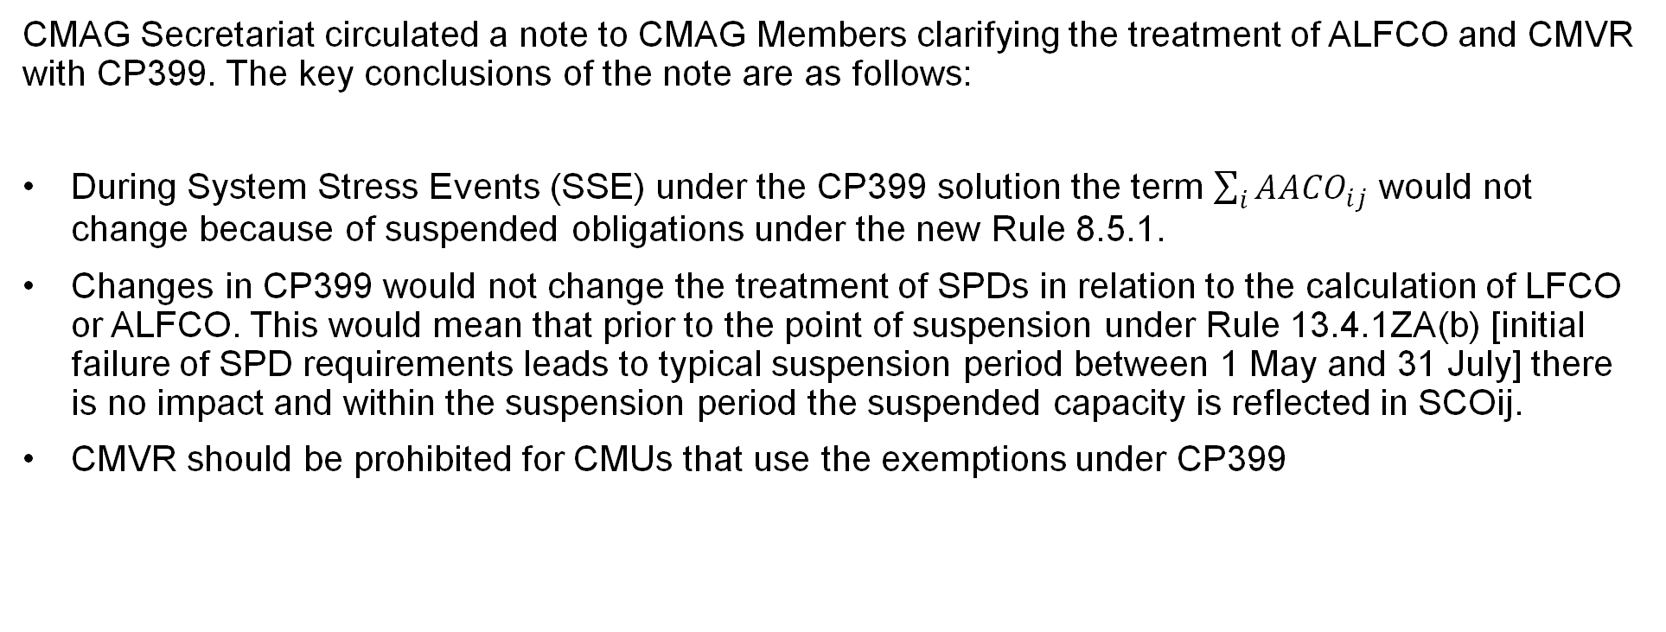
CP399 Updates of ALFCO and CMVR Treatment
CMAG Secretariat circulated a note to CMAG Members clarifying the treatment of ALFCO and CMVR with CP399. The key conclusions of the note are as follows:
During System Stress Events (SSE) under the CP399 solution the term $\sum_{i}{{AACO}_{ij}}$ would not change because of suspended obligations under the new Rule 8.5.1.
Changes in CP399 would not change the treatment of SPDs in relation to the calculation of LFCO or ALFCO. This would mean that prior to the point of suspension under Rule 13.4.1ZA(b) [initial failure of SPD requirements leads to typical suspension period between 1 May and 31 July] there is no impact and within the suspension period the suspended capacity is reflected in SCOij.
CMVR should be prohibited for CMUs that use the exemptions under CP399

Slide 30
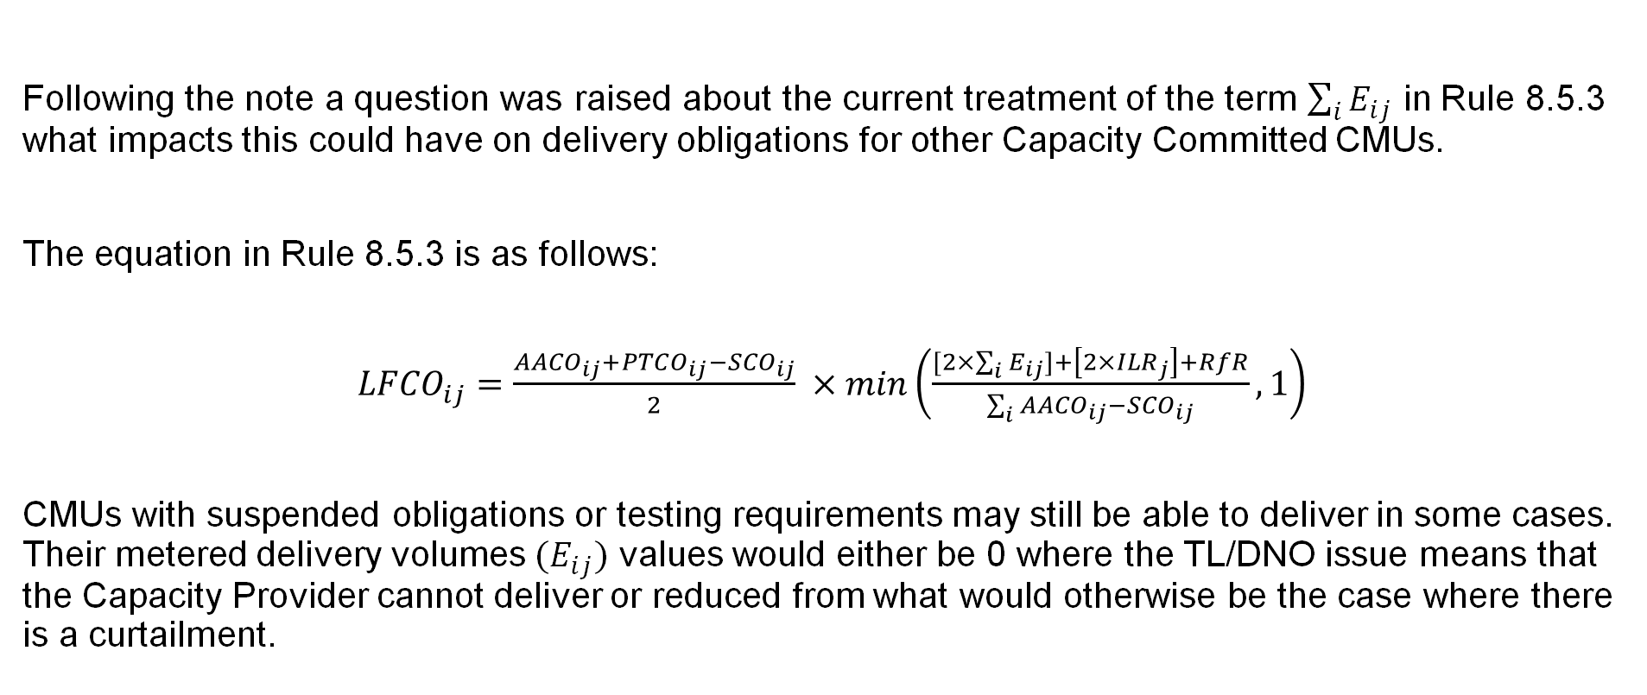
CP399 Updates of ALFCO and CMVR Treatment
Following the note a question was raised about the current treatment of the term $\sum_{i}{E_{ij}}$ in Rule 8.5.3 what impacts this could have on delivery obligations for other Capacity Committed CMUs.
The equation in Rule 8.5.3 is as follows:
${LFCO}_{ij}=\frac{{AACO}_{ij}+{PTCO}_{ij}−{SCO}_{ij}}{2} ×min\left(\frac{[2×\sum_{i}{E_{ij}]+\left[2×{ILR}_{j}\right]+RfR}}{\sum_{i}{{AACO}_{ij}−{SCO}_{ij}}},1\right)$
CMUs with suspended obligations or testing requirements may still be able to deliver in some cases. Their metered delivery volumes $(E_{ij})$ values would either be 0 where the TL/DNO issue means that the Capacity Provider cannot deliver or reduced from what would otherwise be the case where there is a curtailment.

Slide 31
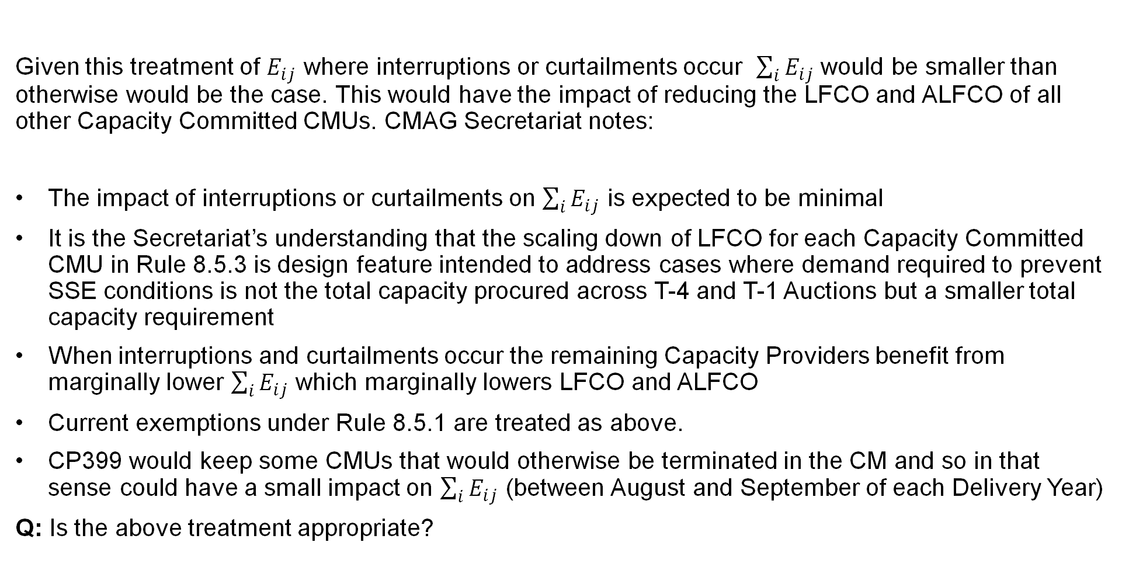
CP399 Updates of ALFCO and CMVR Treatment
Given this treatment of $E_{ij}$ where interruptions or curtailments occur $\sum_{i}{E_{ij}}$ would be smaller than otherwise would be the case. This would have the impact of reducing the LFCO and ALFCO of all other Capacity Committed CMUs. CMAG Secretariat notes:
The impact of interruptions or curtailments on $\sum_{i}{E_{ij}}$ is expected to be minimal
It is the Secretariat’s understanding that the scaling down of LFCO for each Capacity Committed CMU in Rule 8.5.3 is design feature intended to address cases where demand required to prevent SSE conditions is not the total capacity procured across T-4 and T-1 Auctions but a smaller total capacity requirement
When interruptions and curtailments occur the remaining Capacity Providers benefit from marginally lower $\sum_{i}{E_{ij}}$ which marginally lowers LFCO and ALFCO
Current exemptions under Rule 8.5.1 are treated as above.
CP399 would keep some CMUs that would otherwise be terminated in the CM and so in that sense could have a small impact on $\sum_{i}{E_{ij}}$ (between August and September of each Delivery Year)
Q: Is the above treatment appropriate?

Slide 32
CP399 Legal Text Updates
At CMAG 44 Members agreed the following updates to the legal text and these updates have been provided in the updated legal text:
Inclusion of a requirement to inform EMR DB when interruptions or curtailments are no longer applicable
Clear prohibition that where any of the suspensions are in effect the relevant Capacity Committed CMUs cannot participate in CMVR.
Q: Timescales for which SSE ITE reports can be submitted are not confirmed, what should these be [To update following EMR DB Impact Assessment response]

Slide 33
CP399 CMAG Standard Questions
The solution proposed for CP399 is as follows:
Question | Proposer Response
Does the Change Proposal better facilitate the CM Rules Change Objectives? | Yes, Change Proposal better facilitates Objectives (i) promoting investment in capacity to ensure security of electricity supply and (ii) facilitating the efficient operation and administration of the Capacity Market.
Are there any impacts on Regulations? | No impacts on Regulations.
Are there any impacts on other central industry frameworks or obligations impacted directly or indirectly? | No direct or indirect impacts on other frameworks or obligations.

Slide 34
CP399 CMAG Standard Questions
Question | Proposer Response
Are there any impacts on consumers? | Only impacts would be positive. CMU with multi-year agreements where the CMU is fully functional, but testing cannot be met due to an issue the Network Operator is experiencing would not be terminated meaning the capacity would be available again as soon as the Network Operator has resolved their issue. This would also mean the capacity would not need to be re-procured via a T-1 auction or a later T-4. The change also provides assurance to Capacity Providers regarding a risk that is entirely outside their control and could lead to increased participation in the Capacity Market bringing which would bring down the clearing prices.

Slide 35
CP399 CMAG Standard Questions
Question | Proposer Response
Any other related changes to the CM in the pipeline? | None
What is the scale of impact and the costs on CM participants; | Implementation does not entail changes to standard administration of the Capacity Market. I.e., unless a CMU needs to rely on the exceptions this Change Proposal would introduce, their introduction would not require any action from Capacity Providers, EMRS, or the Delivery Body. For CMUs that do need to rely on the exceptions, the costs and impacts associated with obtaining an ITE Report for the Capacity Provider and the administrative cost for the Delivery Body to review the ITE Reports would be offset by the reduction in costs and admin associated with appeals.

Slide 36
CP399 CMAG Standard Questions
Question | Responses
What are the impacts on the CM Delivery Partners including i The impacts on systems and processes; ii Indicative costs to make the proposed changes; and iii Indicative lead times to deliver the proposed changes | TBC with Delivery Partners
h) The draft legal text; | TBC with CMAG
i) Whether the CMAG recommends to Ofgem that the change be made. | TBC with CMAG

Slide 37
Recommendation
The CMAG recommends to Ofgem:​
That the solution better facilitates the CM Rules Change Objectives of:
          Promoting investment in capacity to ensure security of electricity supply.​
          ​ii. Facilitating the efficient operation and administration of the Capacity Market.
c) The draft legal text; and​
d) That CP399 should be implemented.

Slide 38

Forward Work Plan

Slide 39
Forward Work Plan
Review or Subgroup
Initial Consideration of Proposal
Development
CMAG
Recommendation
CMAG Report
Sent to Ofgem
Pre-raise consideration
Key
Anticipated Timelines
CP399 Network disconnect
Duplicate MPANs
Secondary Trading Review
CP373 follow-on items
Removal of System Operator File 6
July
June
July
Jan
August
September
July
August
September
July
August
September
June
June
July
August
September

Slide 40
Prioritised pipeline from Oct / Nov 2025
Title | Category | Priority Score | Predicted Start
Implications of REMA | Review | 25 | Awaiting DESNZ decision on proposed changes for Prequalification 2026
De-Rating Factors | Review | 21
Connection Capacity | Review | 20
Requirement to publish suspensions | Operational Process | 17
Change of Owner | Operational Process | 11
MPAN issues post CP373 | Operational Process | 11
Foreign Currency Methodology | Operational Process | 11

Slide 41
Forward Work Plan
For any support or additional information, you can contact: CMAG@Elexon.co.uk​
Before raising a Change Proposal, you can also raise a CMAG Surgery Item. This allows you to discuss/workshop an idea with CM experts before formally raising a Change Proposal.
To formally enable CMAG to assess, develop, and recommend changes to the CM Rules, please complete a CM Rules Change Proposal Template. This will also allow the CMAG Secretariat to provide support and guidance in developing the proposal, along with our CM Delivery Partners. ​​
Additional information on how to raise a Change Proposal can be found online via: ​
    The Change Process for the Capacity Market Rules – Guidance (Ofgem webpage).​
​
Ofgem has shared that they are committing to a minimum of one consultation per year, OR once a sufficient number of Change Proposals (around 5 or 6) are ready for consultation.

Slide 42

AOB and meeting close

Slide 43
Thank You

